Slide 1
指针与链式结构

Slide 2
溢出问题
顺序存储结构将所有数据存储在数组中，数组的容量固定，需要在编写程序时确定，在程序运行中不能更改（常量）——写程序时需要确定数组容量的上限
数组容量确定不当，程序运行过程中空间不足，就会出现overflow

Slide 3
指针
能有效解决上述溢出问题
指针有时称为链域或引用，
它是一个对象，通常是一个变量。它存储其它对象，通常是含有我们希望处理的数据的有结构对象的地址。
如果我们用指针来定位我们关心的所有数据，就不用考虑这些数据到底放在那里，因为使用指针可以使计算机系统自己定位我们要找的数据。

Slide 4
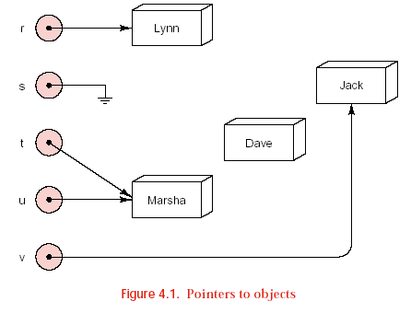
有关图的约定
Variable contain pointers

Slide 5
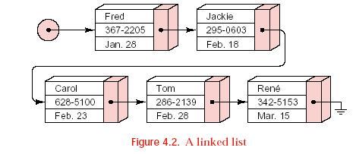
链式结构
链表的基本思想是借助指针指示线性表中下一个元素的位置
Notes:
Augment 增加，增大

Slide 6
动态内存分配
动态分配内存
优势在于：开始时占用足够小的内存，运行中按需要分配内存，运行更有效，而且内存的限制就是计算机系统存储空间的大小
自动对象
程序中明确命名，存储空间由系统按生存周期分配
动态对象
程序执行过程中动态生成和销毁的，由程序员控制。

Slide 7
基本链式结构
Nodes and Type Declarations
struct Node {
// data members
Node_entry entry;
Node *next; //use before definition
// constructors
Node( );
Node(Node_entry item, Node *add_on = NULL);
};

Slide 8
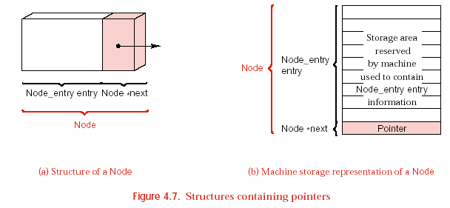
基本链式结构

Slide 9
基本链式结构
Node Constructors
Node :: Node( )
{
next = NULL;
}
The second form accepts two parameters for initializing the data members.
Node :: Node(Node_entry item, Node *add_on)
{
entry = item;
next = add_on;
}

Slide 10
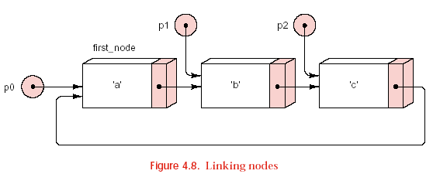
基本链式结构
Node first_node(‘a’); // Node first_node stores data ’a’.
Node *p0 = &first_node; // p0 points to first_Node.
Node *p1 = new Node(‘b’); // A second node storing ‘b’ is created.
p0->next = p1; // The second Node is linked after first_node.
Node *p2 = new Node(‘c’, p0); // A third Node storing ‘c’ is created.
// The third Node links back to the first node, *p0.
p1->next = p2; // The third Node is linked after the second Node.

Slide 11
栈的链式实现

Slide 12
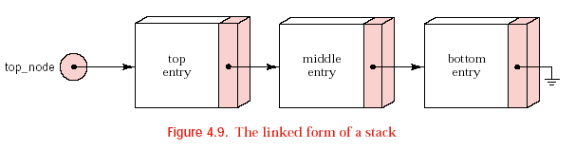
链栈
typedef Stack_entry Node_entry;(用结点来存放栈的元素)
Whether the beginning or the end of the linked structure
will be the top of the stack?
The only information needed to keep track of the data
in a linked stack is the location of its top.

Slide 13
链栈
declaration of type Stack
class Stack {
public:
Stack( );
bool empty( ) const;
Error_code push(const Stack_entry &item);
Error_code pop( );
Error_code top(Stack_entry &item) const;
protected:
Node *top_node;
};

Slide 14
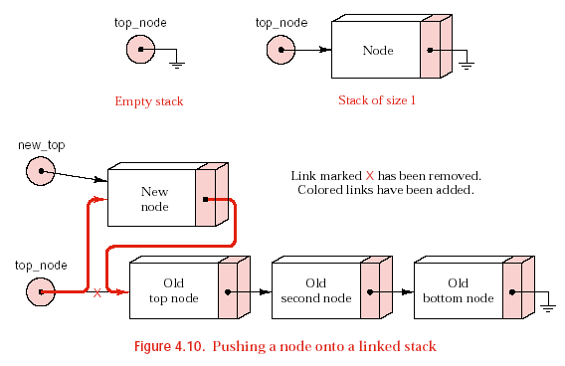
链栈
pushing a linked stack（入栈）

Slide 15
链栈
pushing a linked stack（入栈）
Error_code Stack :: push(const Stack_entry &item)
/* Post: Stack_entry item is added to the top of the Stack; returns success or returns a code of overflow if dynamic memory is exhausted. */
{
Node *new_top = new Node(item, top_node);
if (new_top == NULL) return overflow;
top_node = new_top;
return success;
}

Slide 16
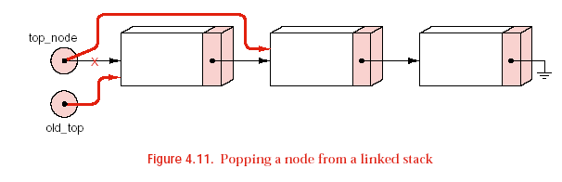
链栈
popping a linked stack（出栈）
Error_code Stack :: pop( )
/* Post: The top of the Stack is removed. If the Stack is empty the method returns underflow; otherwise it returns success. */
{
Node *old_top=top_node;
if (top_node==NULL) return underflow;
top_node=top_node->next;
delete old_top;
return success;
}

Slide 17
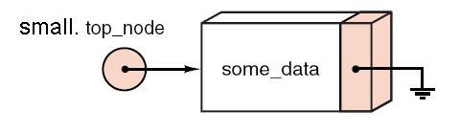
链栈的几点安全性修正
Problem Example
for (int i = 0; i < 1000000; i++) {
Stack small;
small.push(some_data);
}
As soon as the object small goes out of scope, the data stored in small becomes garbage. Over the course of a million iterations of the loop, a lot of garbage will accumulate.

Slide 18
链栈的几点安全性修正
The Destructor
C++ 中提供了析构函数，于对象死亡前系统自动调用，用于释放相关资源。
Stack :: ~ Stack( ) // Destructor
/* Post: The Stack is cleared. */
{
while (!empty( ))
pop( );
}

Slide 19
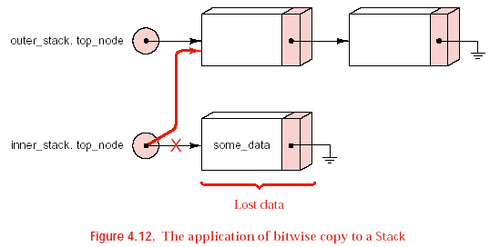
链栈的几点安全性修正
Stack outer_stack;
for (int i = 0; i < 1000000; i++) {
Stack inner_stack;
inner_stack.push(some_data);
inner_stack = outer_stack;
}
存在的错误:
数据空间丢失
两个栈共享节点
inner_stack删除了outer_stack的内容，导致outer_stack.top_ node的指向无效

Slide 20
链栈的几点安全性修正
void Stack :: operator = (const Stack &original) // Overload assignment
/* Post: The Stack is reset as a copy of Stack original. */
{ Node *new_top, *new_copy, *original_node = original.top_node;
if (original_node == NULL) new_top = NULL;
else { // Duplicate the linked nodes
new_copy = new_top = new Node(original_node->entry);
while (original_node->next != NULL) {
original_node = original_node->next;
new_copy->next = new Node(original_node->entry);
new_copy = new_copy->next;
}
}
while (!empty( )) // Clean out old Stack entries
pop( );
top_node = new_top; // and replace them with new entries.
}

Slide 21
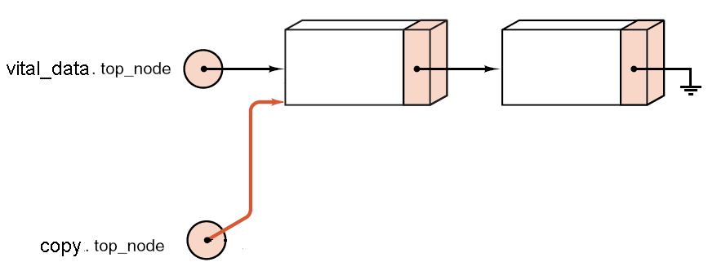
链栈的几点安全性修正
拷贝构造函数
Problem example:
void destroy_the_stack (Stack copy)
{
}
int main( )
{
Stack vital_data;
……
destroy_the_stack(vital_data);
}

Slide 22
链栈的几点安全性修正
Main(){
Stack p1;
P1.push(somedata);
Stack p2(p1);//Stack p2=p1;
…..
}
解决方案：拷贝构造函数
Stack :: Stack(const Stack &original);

Slide 23
链栈的几点安全性修正
Stack :: Stack(const Stack &original) // copy constructor
/* Post: The Stack is initialized as a copy of Stack original. */
{
Node *new_copy, *original_node = original.top_node;
if (original_node == NULL) top_node = NULL;
else { // Duplicate the linked nodes.
top_node = new_copy = new Node(original_node->entry);
while (original_node->next != NULL) {
original_node = original_node->next;
new_copy->next = new Node(original_node->entry);
new_copy = new_copy->next;
}}}

Slide 24
链栈的几点安全性修正
有了拷贝构造函数，赋值运算的重载可变为：
void Stack :: operator = (const Stack &original) {
Stack new_copy(original);
top_node = new_copy.top_node;
}

Slide 25
修正后的链栈
class Stack {
public:// Standard Stack methods
Stack( );
bool empty( ) const;
Error_code push(const Stack_entry &item);
Error_code pop( );
Error_code top(Stack_entry &item) const;
// Safety features for linked structures
~Stack( );
Stack(const Stack &original);
void operator = (const Stack &original);
protected:
Node *top_node;
};

Slide 26
队列的链式实现

Slide 27
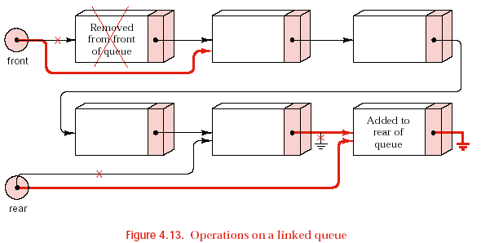
链式队列

Slide 28
链式队列
class Queue {
public:
// standard Queue methods
Queue( );
bool empty( ) const;
Error_code append(const Queue_entry &item);
Error_code serve( );
Error_code retrieve(Queue_entry &item) const;
// safety features for linked structures
~Queue( );
Queue(const Queue &original);
void operator = (const Queue &original);
protected:
Node *front, *rear;
};

Slide 29
链式队列
初始化：
空队，无任何数据元素，front和rear均为NULL
Queue :: Queue( )
/* Post: The Queue is initialized to be empty. */
{
front = rear = NULL;
}

Slide 30
链式队列
入队
Error_code Queue :: append(const Queue_entry &item)
/* Post: Add item to the rear of the Queue and return a code of success or return a code of overflow if dynamic memory is exhausted. */ {
Node *new_rear = new Node(item);
if (new_rear == NULL) return overflow;
//原为空队，新入队元素即是队头，也是队尾
if (rear == NULL) front = rear = new_rear;
else {//原为非空队，只需修改rear，与front无关
rear->next = new_rear;
rear = new_rear;
}
return success;
}

Slide 31
链式队列
出队
Error_code Queue :: serve( )
/* Post: The front of the Queue is removed. If the Queue is empty, return an Error_code of underflow. */ {
if (front == NULL) return underflow;
Node *old_front = front; //保存好原来的队头结点
front = old_front->next;
//原队列只有一个元素，出队后，rear也需要修改
if (front == NULL) rear = NULL;
delete old_front; //归还原队头结点
return success;
}

Slide 32
链式队列
扩展的链式队列
class Extended_queue: public Queue {
public:
bool full( ) const;
int size( ) const;
void clear( );
Error_code serve_and_retrieve(Queue_entry &item);
};
注：安全性的修正（析构函数、赋值运算符重载、拷贝构造函数）以继承的方式获得，无需再显式定义。

Slide 33
链式队列
void Extended_queue :: clear( ) {
Node *window = front;
while (window != NULL) {
front=front->next;
delete window;
window =front;
}
}
或者
void Extended_Queue :: clear(){
while (!empty())
serve();
}

